Slide 1
Gen-AI based data profiling
Team: SB-Trailblazers
Team: Pranayee Kusuma Sricharith

Slide 2





Problem Statement
Regulatory Reporting in Banking – Requires compiling large volumes of data to meet compliance standards.
Data Profiling Criticality – Ensures reported data aligns with regulatory instructions.
Manual Rule Definition – Current process relies on manually defining profiling rules and flagging transactions
Challenges – Time-consuming, error-prone, and dependent on regulatory & data understanding.
Need for Efficiency – Requires automation or smarter solutions to improve accuracy & speed.

Slide 3





Solution Overview & Opportunity
“Build a tool based on LLM that can dynamically create rules analyse financial data to improve auditor productivity multifold”
Build a dynamic risk scoring depending on historical data patterns and regulatory rules
Action items for flagged transactions including risk explanations
User Friendly interface for auditor to input files, drop in remarks and ability to generate reports and view dashboards
Use Deepseek to process and interpret regulatory reporting instructions
Build a dynamic rules engine based on input document as well as by infering the context from the uploaded transaction document

Slide 4
Key Features
Comprehensive Rules Engine: Automates rule generation by considering both Federal Reserve regulations and context-specific compliance requirements.
Real-Time Risk Segmentation: Interactive dashboard for risk scoring and flagged transaction insights, enabling proactive decision-making. Risk categories: Credit risk, market risk, transaction risk, operational risk
Automated Transaction Analysis: Provides dynamic recommendations for any sample transaction dataset, ensuring actionable insights.
Multi-Format Data Processing: Seamlessly integrates and processes diverse file formats, adapting to real-time regulatory scenarios
Multiple Files Input: Ability to analyze rules from multiple files and create a dynamic rule engine

Slide 5
The Approach (1)
Step 1: Transaction File Identification & Analysis
Detect and analyze transaction files dynamically, regardless of file name.
Extract and categorize all headers from the data.
Infer that the file contains transaction data based on its structure and content.
Step 2: Header & Data Type Inference
Identify field names and data types, even when ambiguous.
Use context-based understanding to determine appropriate header names.
Step 3: Regulatory Document Parsing
Recognize regulatory documents dynamically based on content, not just file names.
Extract references to transaction-related rules and constraints.
Step 4: Rule Extraction from Regulatory Document
Systematically scan the document, including tables, to extract:
Thresholds, allowable values, conditions, and constraints.
Explicit and implicit rules related to transaction data fields.

Slide 6
The Approach (2)
Step 5: Dynamic Rule Generation & Interdependencies
Generate multiple validation rules dynamically based on data and regulations.
Detect interdependent rules and categorize them accordingly.
Identify rule priorities and implications for compliance checks.
Step 6: Transaction Data Validation
Apply extracted rules to validate transactions, including:
Logical checks (e.g., numeric validation for customer names, transaction format checks).
Pattern-based anomaly detection for transactions by customers.
Special conditions (e.g., overdraft accounts, high-value transactions).
Threshold-based checks dynamically adjusted based on regulatory requirements.
Generate additional rules dynamically based on detected patterns.

Slide 7
The Approach (3)
Step 7: Risk Scoring Framework
Define a dynamic risk scoring mechanism.
Score each transaction based on compliance with rules, historical patterns, and anomalies.
Provide both existing risk scores (if available) and AI-generated scores.
Step 8: Risk Categorization & Segmentation
Segment risks into four key categories:
Credit Risk
Transaction Risk
Market Risk
Operational Risk
Provide risk scores for each category along with an overall risk score.
Step 9: Flagging & Justifications
Flag non-compliant transactions with clear explanations.
Reference regulatory guidelines and rules when flagging transactions.
Provide details on why a transaction was flagged and recommended next steps.

Slide 8
Challenges
Regulatory Document Processing – Extracting structured rules from unstructured legal text and tables.
Dynamic Rule Generation – Creating adaptable validation rules based on transaction data, not hardcoded logic.
Transaction Data Validation – Handling large datasets, real-time anomaly detection, and commonsense rule generation.
Risk Scoring & Categorization – Developing an explainable, dynamic scoring model across multiple risk dimensions.
File Identification & Parsing – Inferring file types dynamically and handling multiple formats (CSV, JSON, PDFs).
Header & Data Type Inference – Resolving ambiguous field names and ensuring correct data type recognition.
Scalability & Performance – Efficiently processing millions of transactions with low latency.
Handling Conflicting or Implicit Rules – Prioritizing or reconciling overlapping regulatory requirements.
Providing Actionable Recommendations – Generating meaningful, regulation-backed suggestions for flagged transactions.
JSON Output Structuring – Maintaining consistency, traceability, and adaptability in the output format.
Security & Compliance – Ensuring data privacy, encryption, and compliance with banking regulations.
Exception Handling – Managing missing data, corrupt files, and evolving regulatory updates.

Slide 9

DEMO VIDEO
https://drive.google.com/file/d/1KMgMSsxN4hf655WkqGVw8754GfOmk_ZF/view?usp=sharing

Slide 10
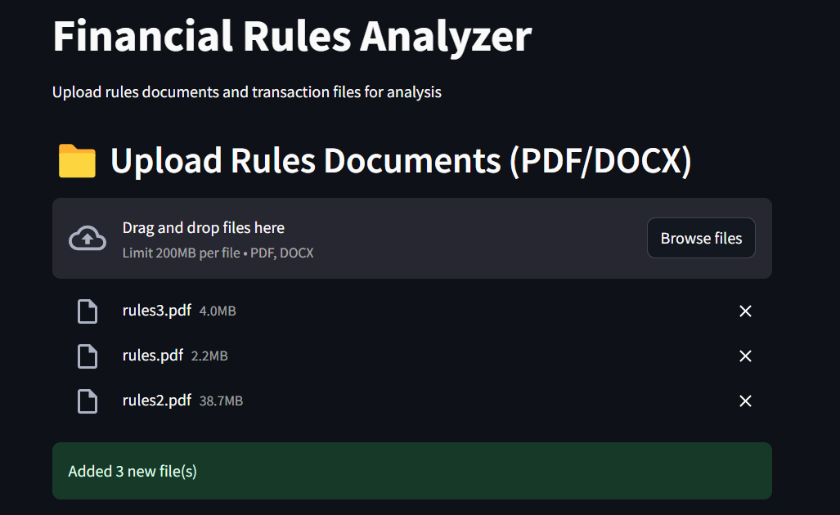
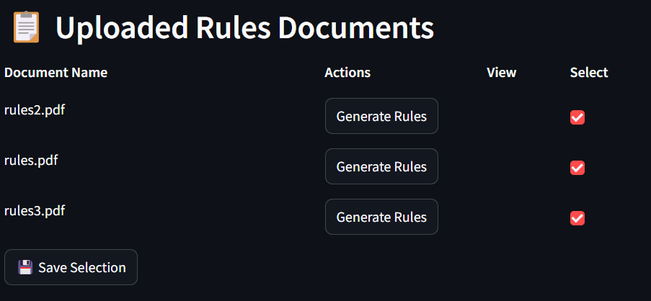
Solution (1)
Financial Rules analyser engine:
The rules engine takes in the files that contain specific regulatory instructions.
We can select one or more regulatory documents as an input file. Then we need to select the relevant documents for generating the rules
Link For the app: https://hkthntrailblazers.streamlit.app/

Slide 11
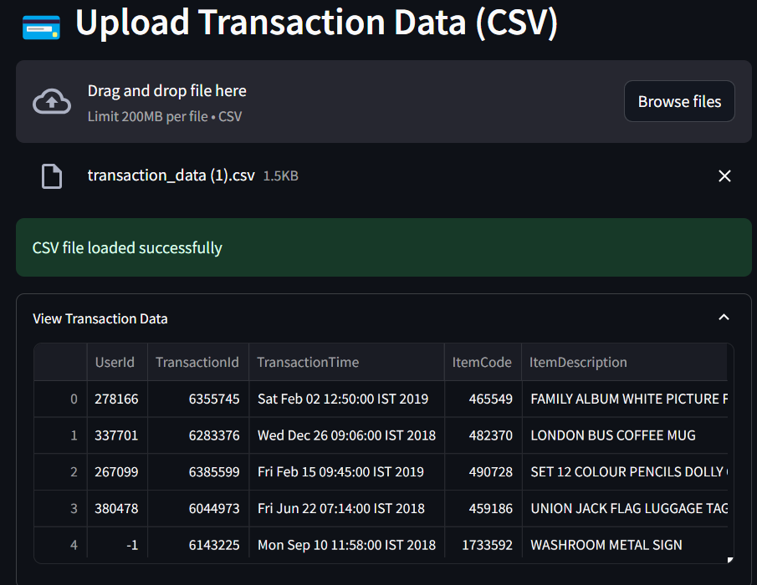
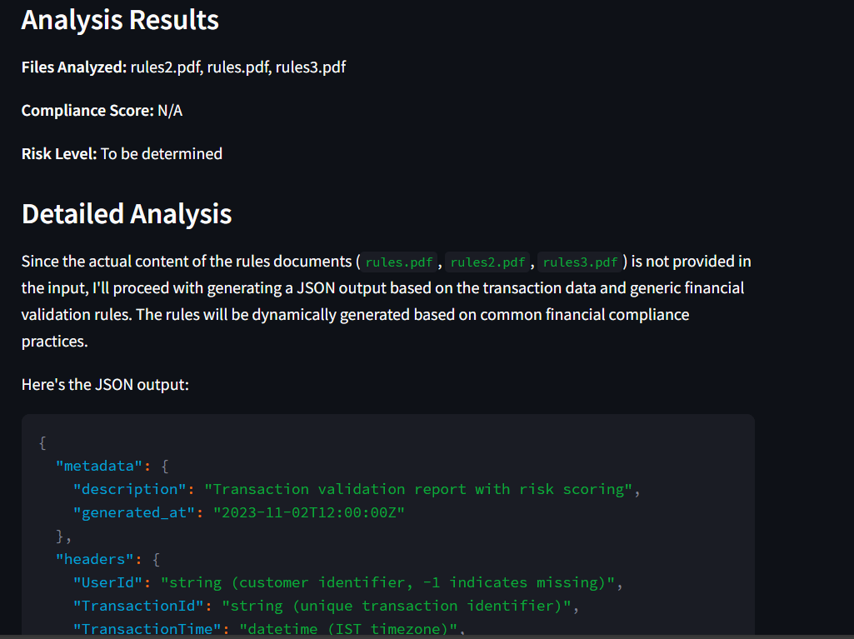
Solution (2)
The transactional data as input file
The analysis results as output

Slide 12
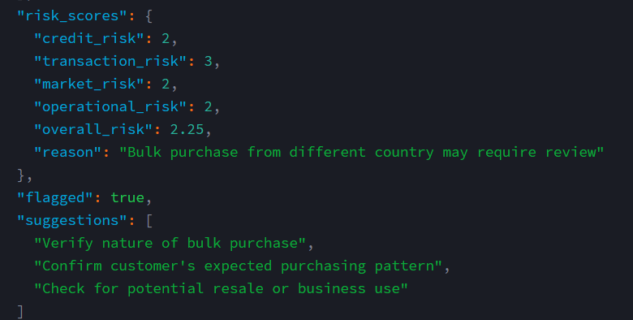
Solution (3)
Flagging high risk transactions and providing suggestions:

Slide 13
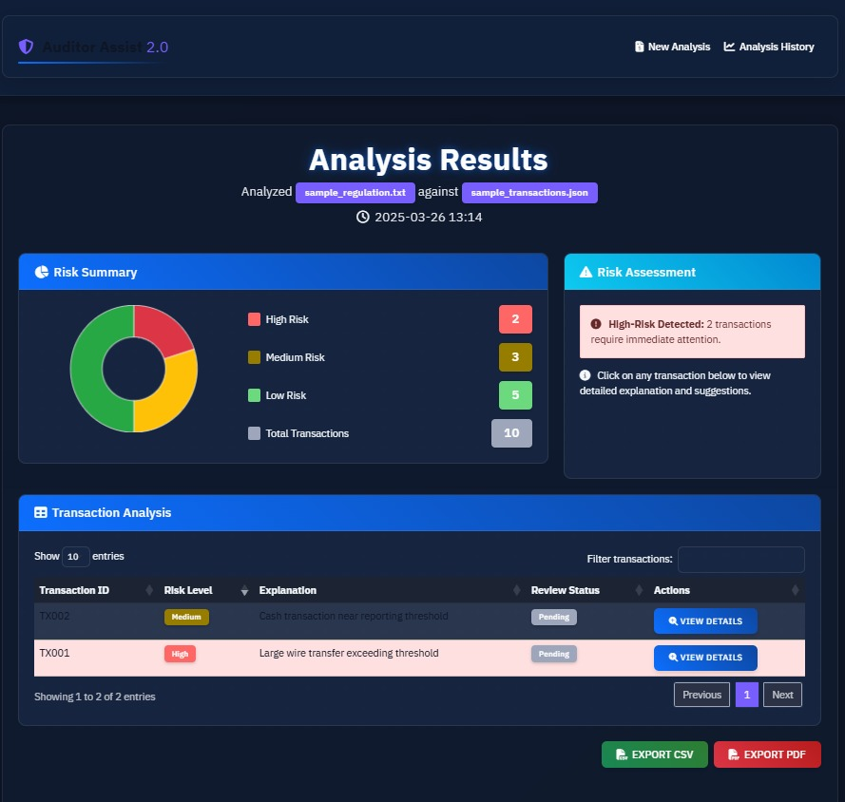
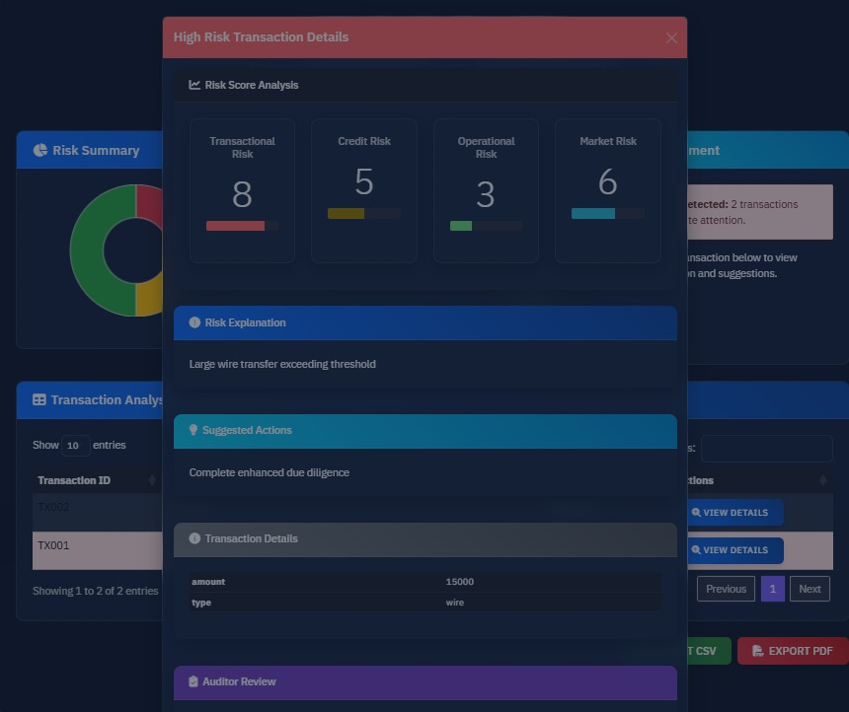
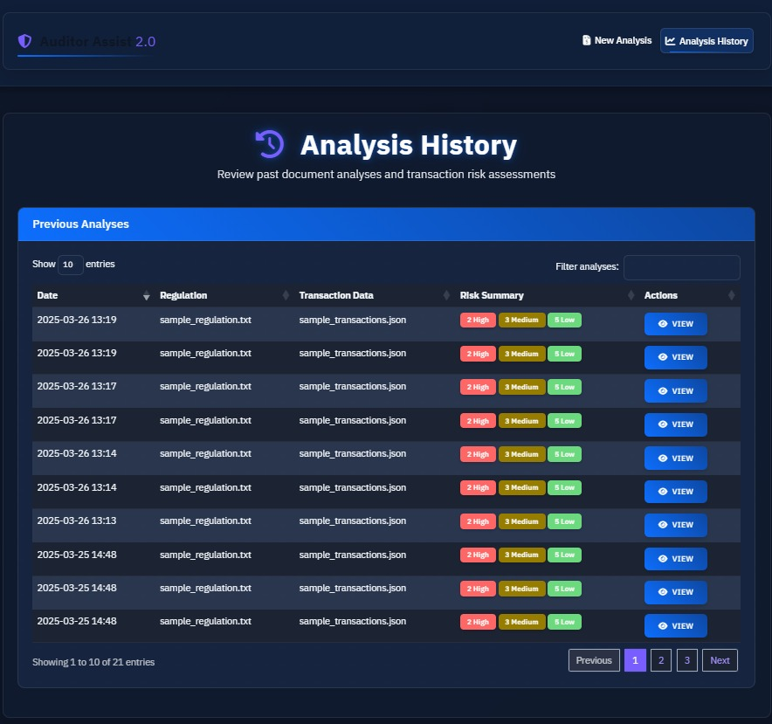
Solution (4)
The dashboard for monthly reporting

Slide 14
THANK YOU!

